Slide 1
Art Bible
Overview of “_insert name later_”, where the player is put into a cramped gauntlet, and must fend of waves of zombies.

Slide 2
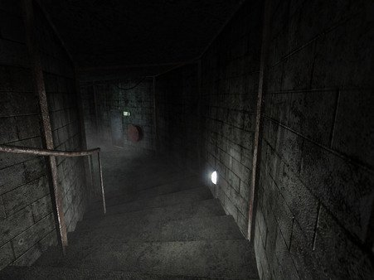
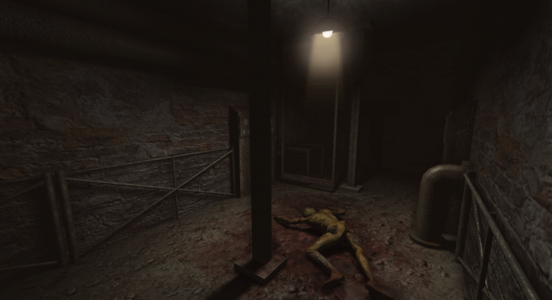
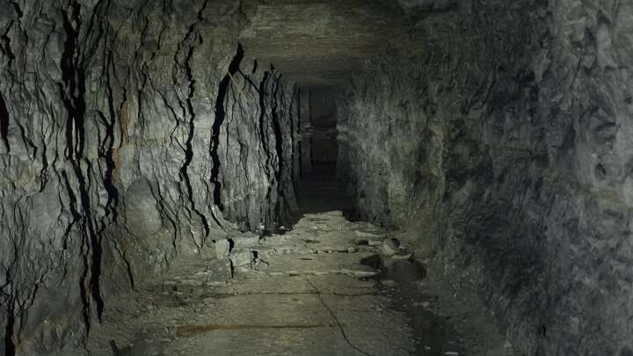
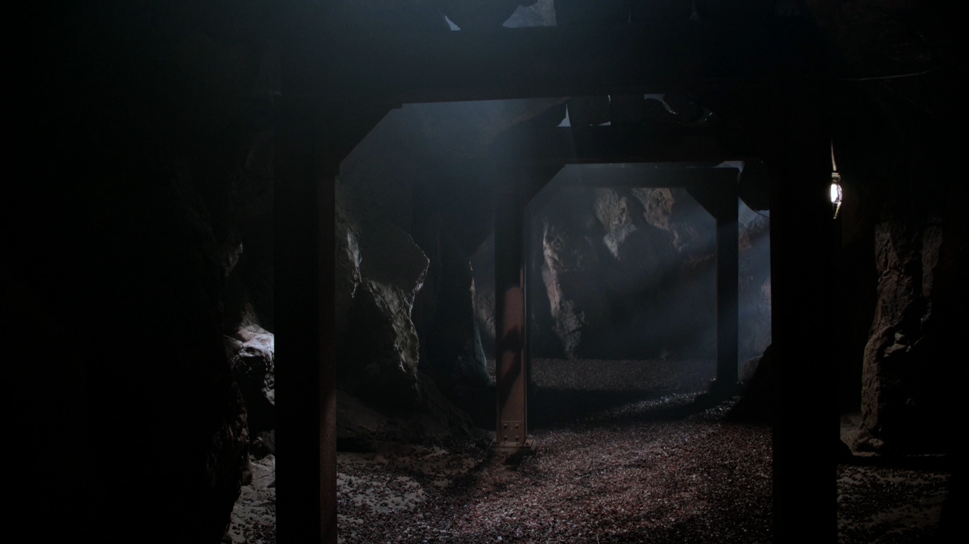
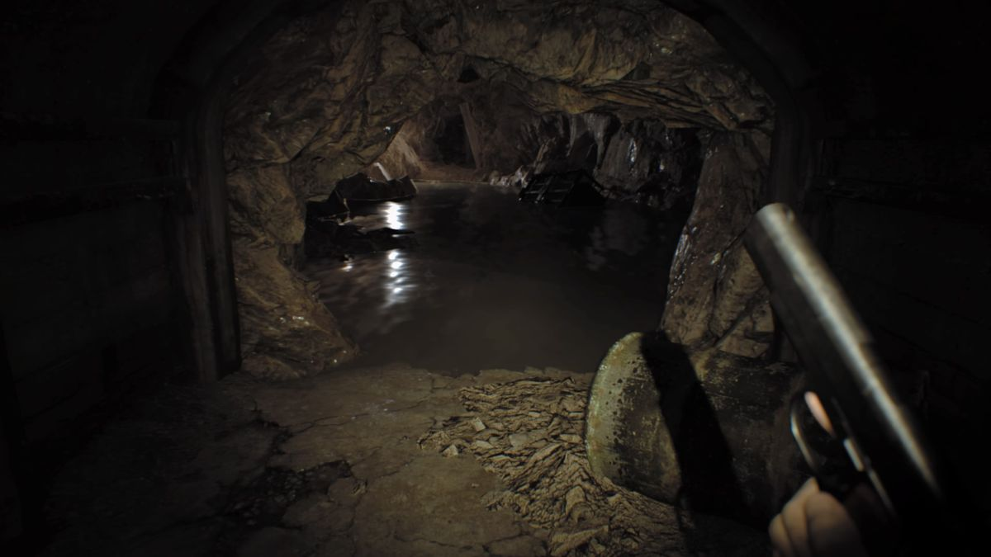
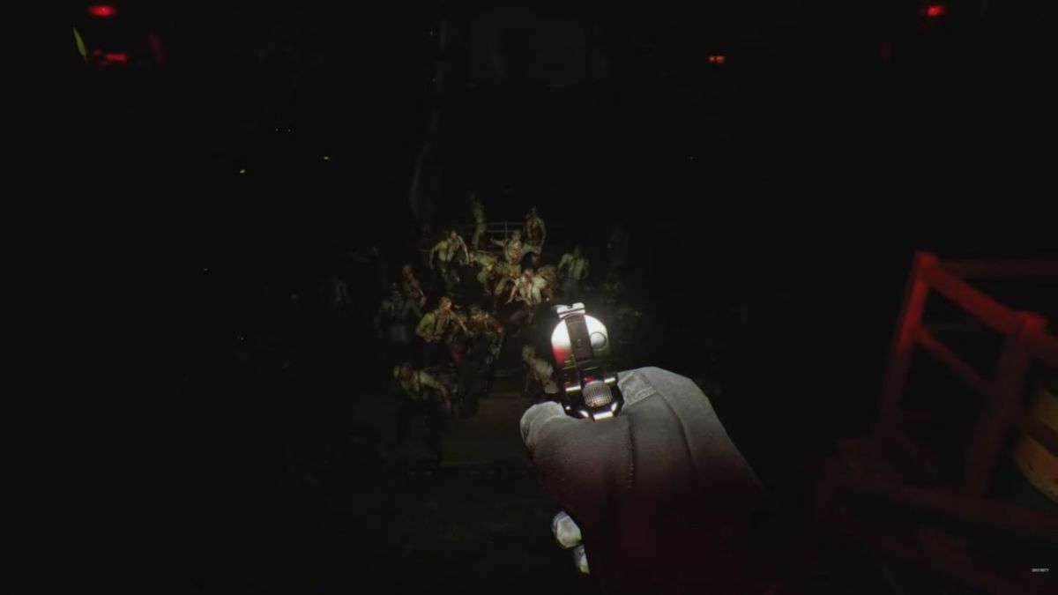
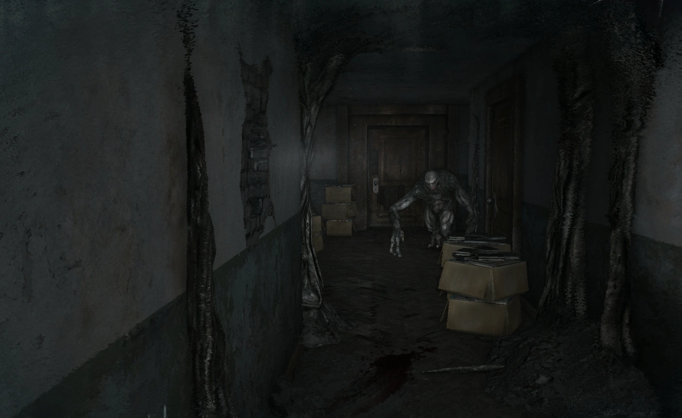
Mood Board
Cramped, confined
Dark, obscured
Semi Modern, Gritty

Slide 3

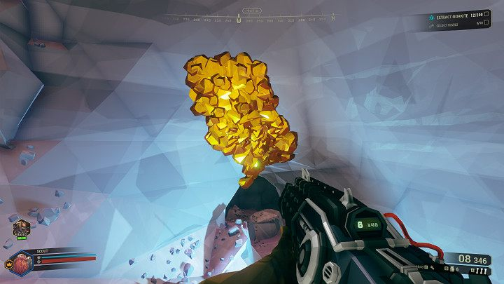
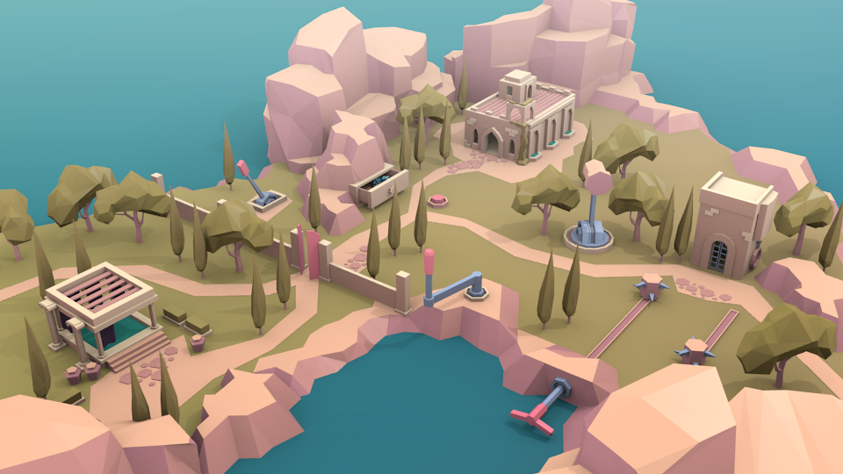
Art Style
Low poly, simple texturing.
Flat colours
Angular geometry

Slide 4
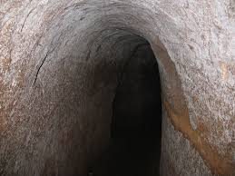
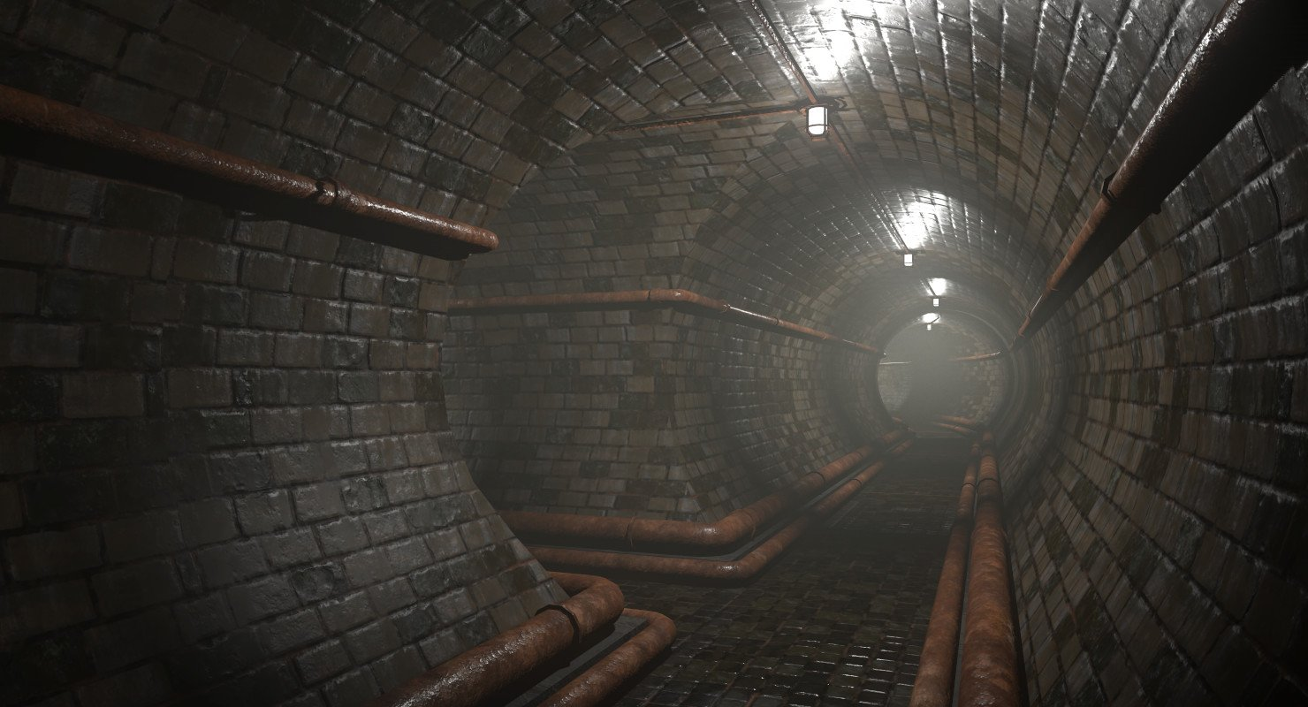
Environment/Atmosphere
Underground tunnels.
Dark, damp, cramped atmosphere.
Light fog in tunnels.

Slide 5
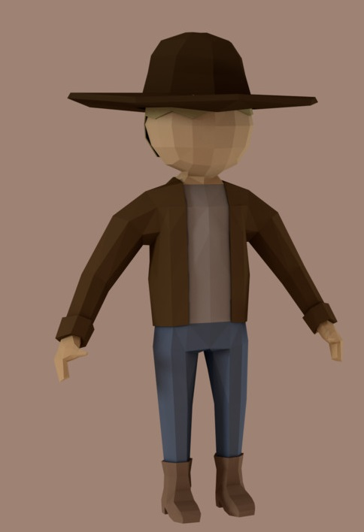
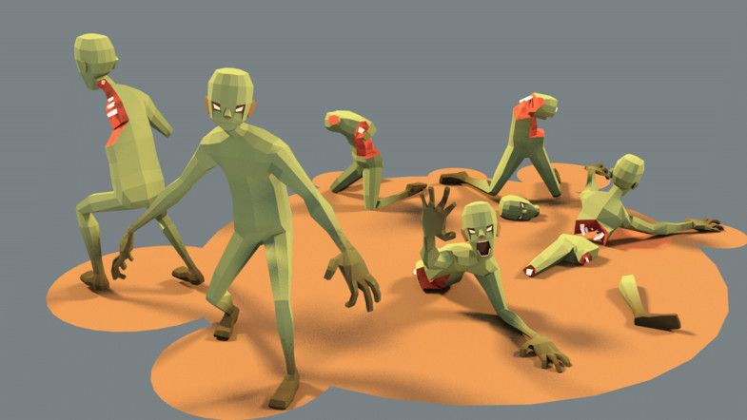
Characters
Zombie, has no mouth. Comes in 3 types: Default: Green Fast: Light Green Heavy: Dark Green
Player, cowboy. Looks semi modern, has a shotgun.

Slide 6
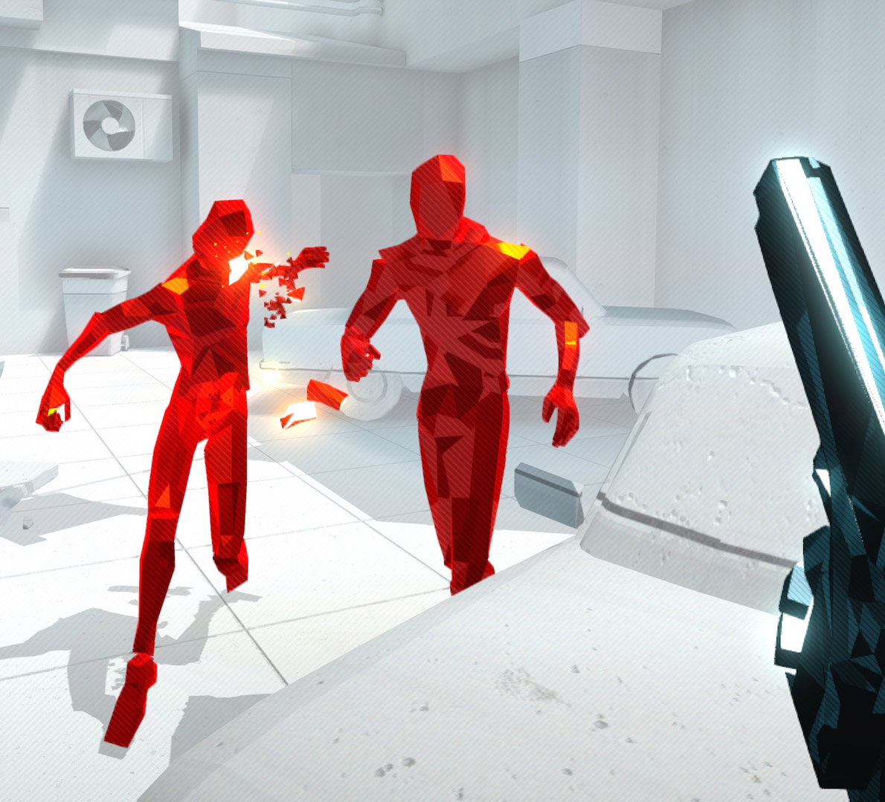
Level of Detail
Low LOD, main focus on model geometry.
Materials to reflect light, highlights lighting.

Slide 7
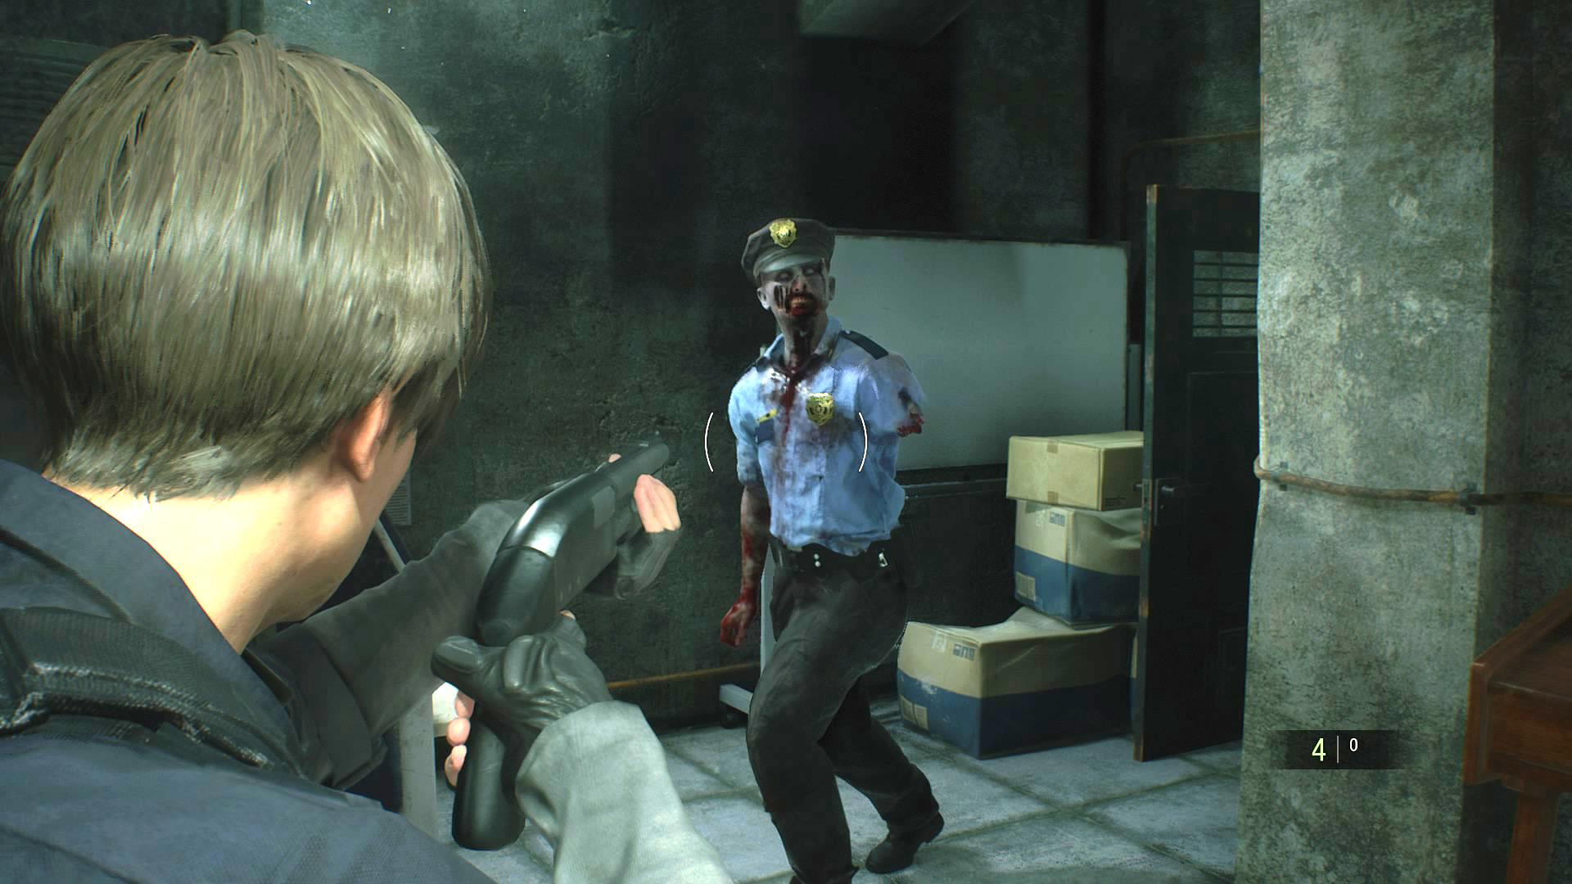
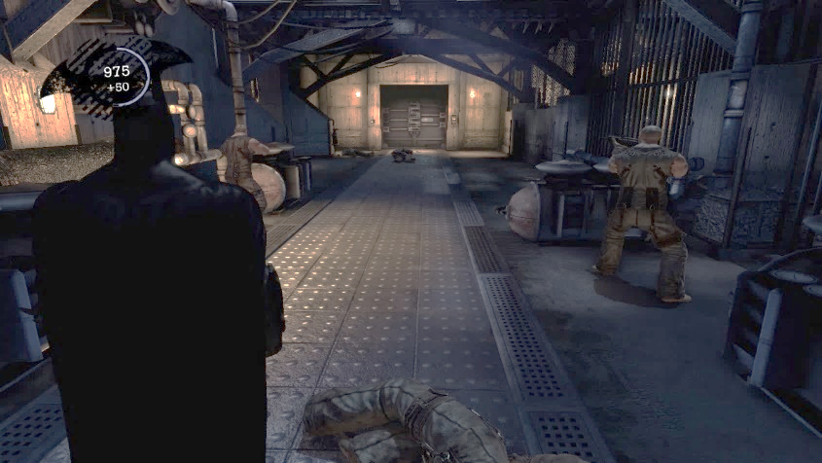
Camera
Over the shoulder, third person.
When aiming, sight of the player should follow down the shoulder + gun.
More behind player when not shooting.

Slide 8
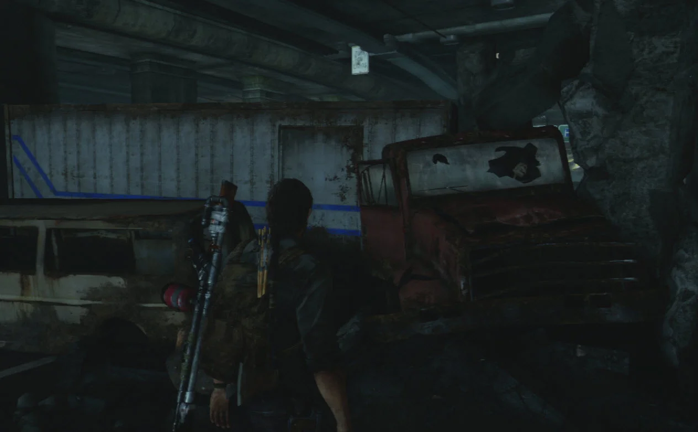
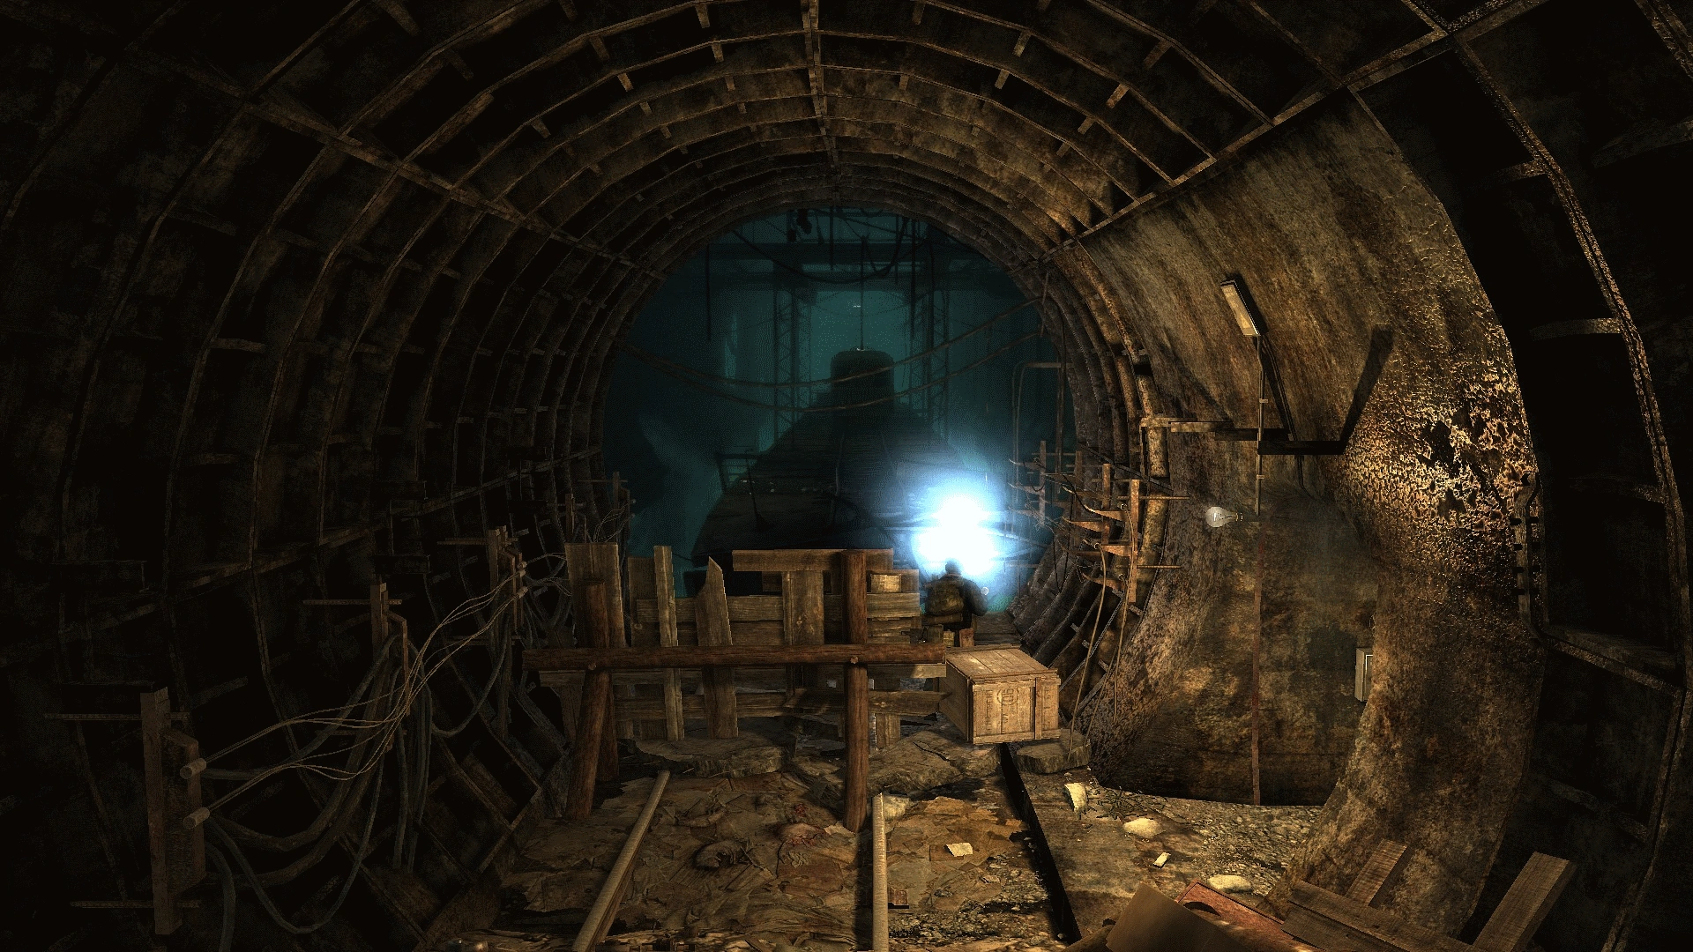
Lighting
Dark, but not pitch black, visible without light source.

Slide 9



Colour Palette
Dark colour palette for the environment. Ages stone and rusted metal.
Sickly green colour palette for the zombies/enemies.
Warmer, faded browns/orange for player and ammo.

Slide 10
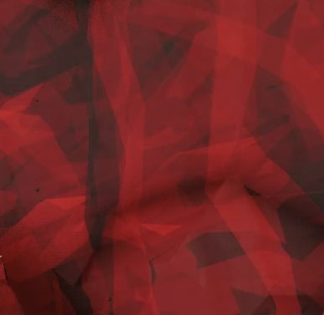
Texture and Surface
Low texture details, flat texturing.
Surface will be smooth and lacking depth. Not a main focus of the artstyle.

Slide 11
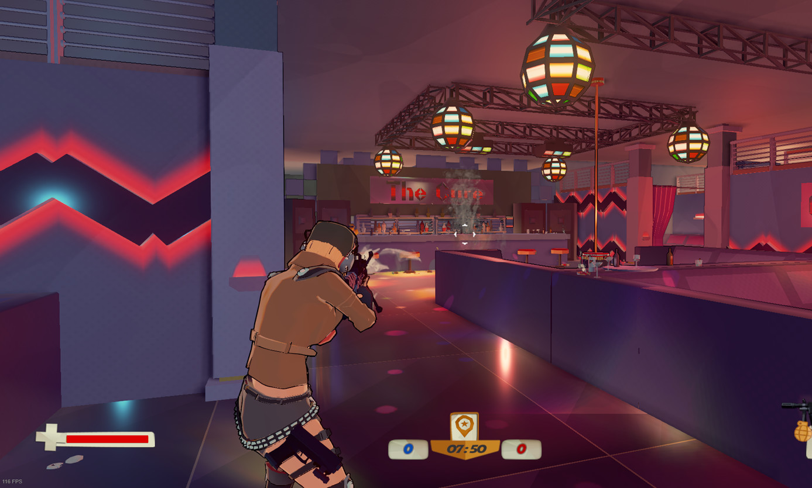
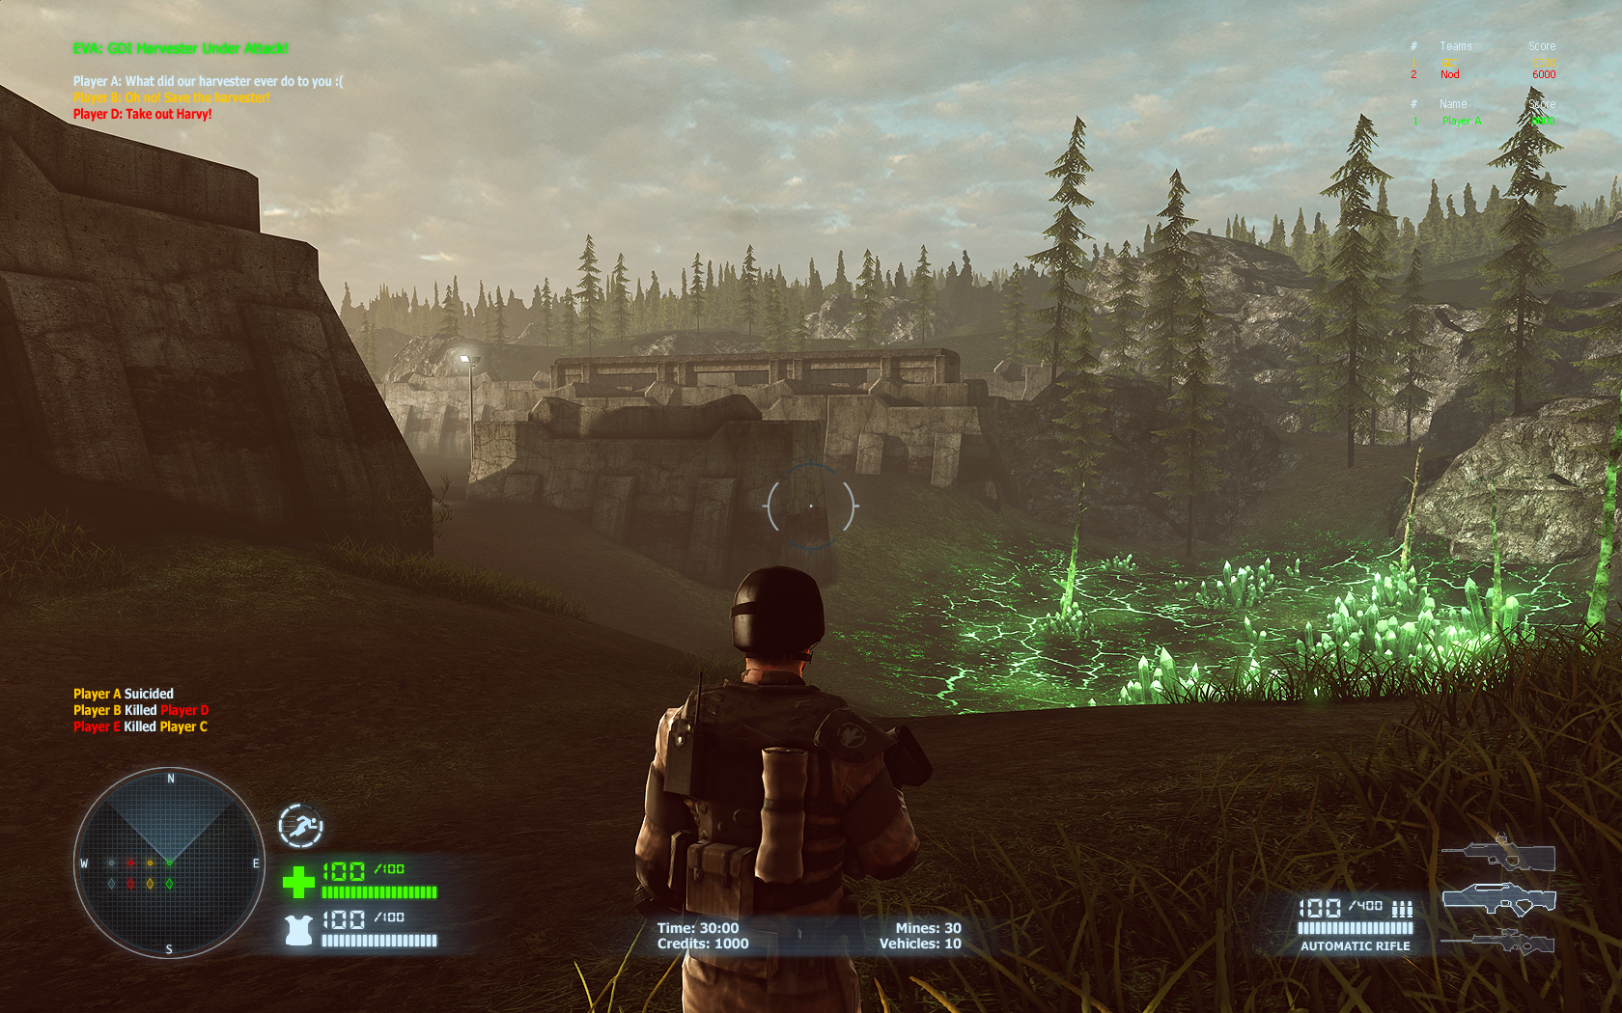
User Interface
At bottom & center of screen. Shows ‘Health’ and ‘Ammo’.
Counter on the top left showing enemy count.
Far away from players main line of sight on screen to avoid confusion.

Slide 12
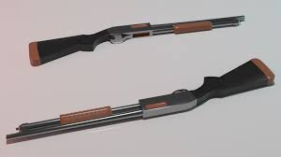
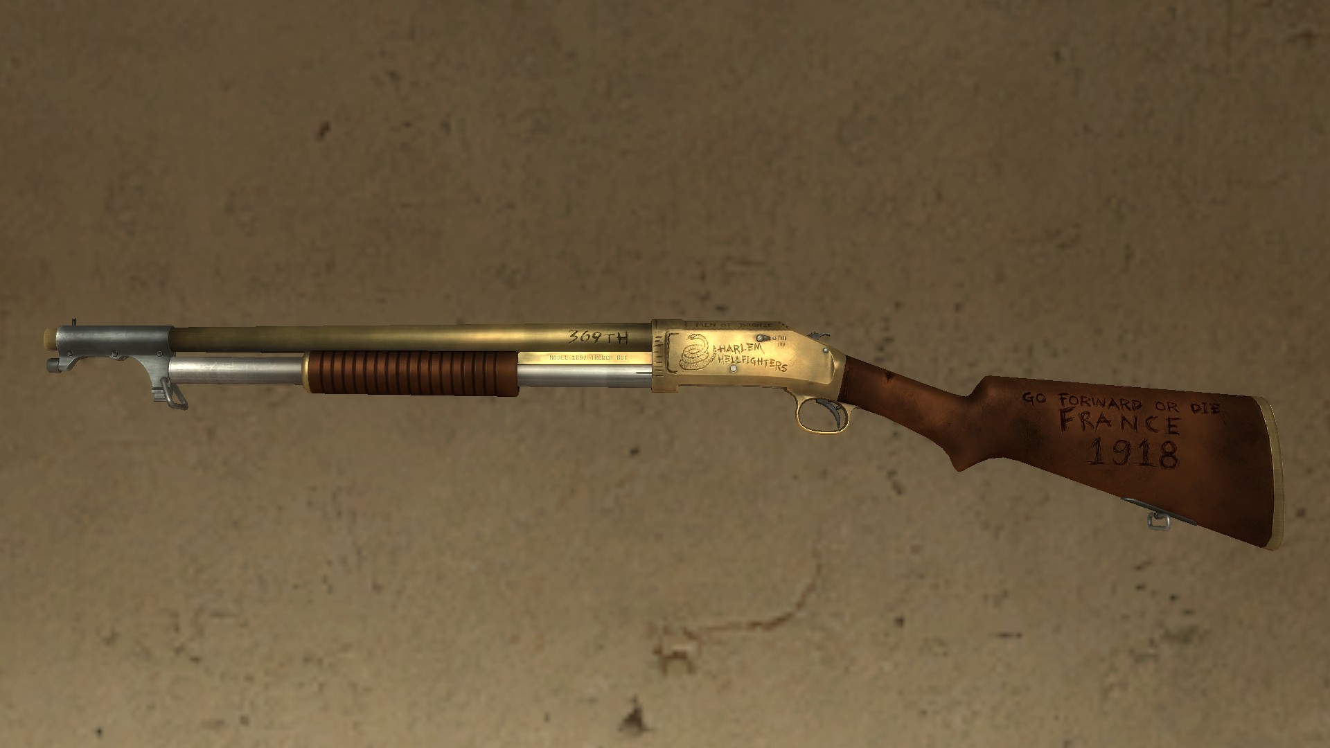
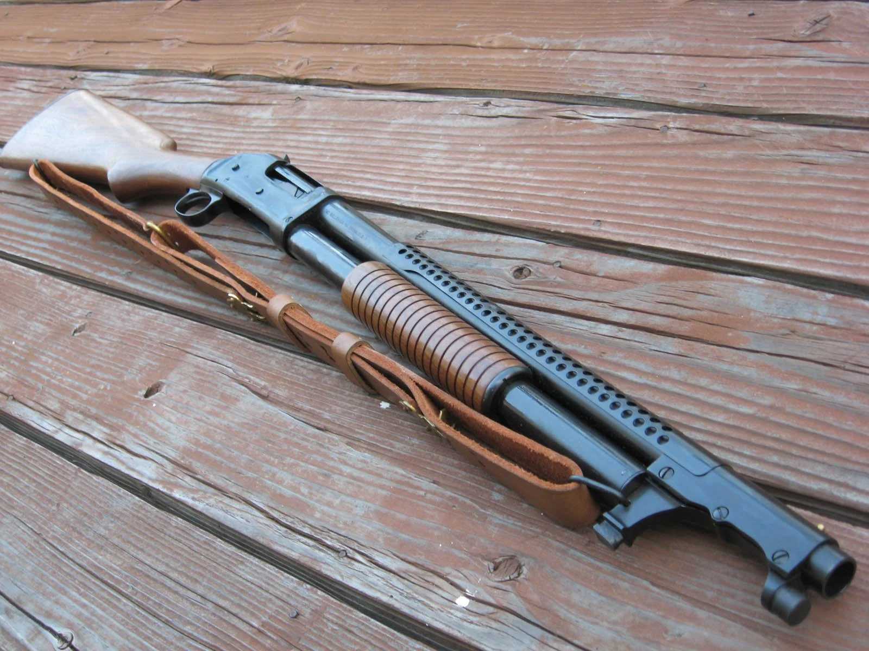
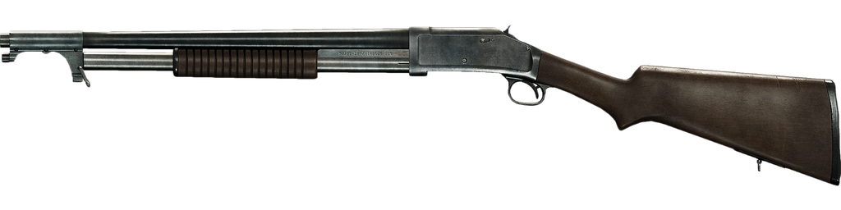
Key Asset: Shotgun
Dimensions: 70cm long, 16cm wide, 22cm tall.
Materials: Wood for stock + slide. Metal for barrel + hammer + trigger.

Slide 13
Design Rules

Slide 14
Art Tools

Slide 15
Technical Guidelines

